Slide 1

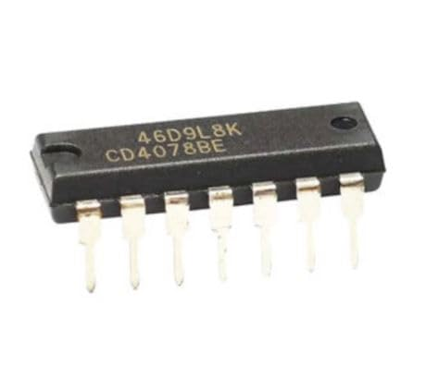
Shri Ramdeobaba College Of Engineering and Managment Nagpur
Department of
Electronics and Communication Engineering
Academic Session 2023-2024
Presentation On The Topic – CMOS Logic Gates
Course Name – Comprehensive Viva
Presented by:-
Name:-Ganesh Narayan Moroliya
Section: A
Batch : A2
Roll No:-102

Slide 2
Contents:-
Introduction
Why CMOS Gates?
3) What is CMOS Logic ?
4) Implementation of Logic Gates using CMOS Logic
5) Basic Logic Gates
6) The CMOS Inverter or NOT Gate
7) NAND Gate ,AND Gate, NOR Gate, OR Gate, XOR Gate, XNOR Gate
8) Application of CMOS Logic Gates
9) Conclusion

Slide 3
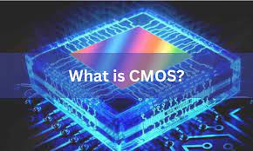
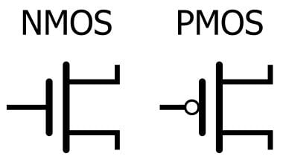
Introduction :-
CMOS :- Complementary Metal-Oxide-Semiconductor
widely used technology in the design and fabrication of integrated circuits.
It behaves like logical gate. (Inverter)
CMOS = PMOS + NMOS
Logic gates that are the basic building block of digital systems
Logic Family
1)TTL
2)ECL
3)CMOS

Slide 4
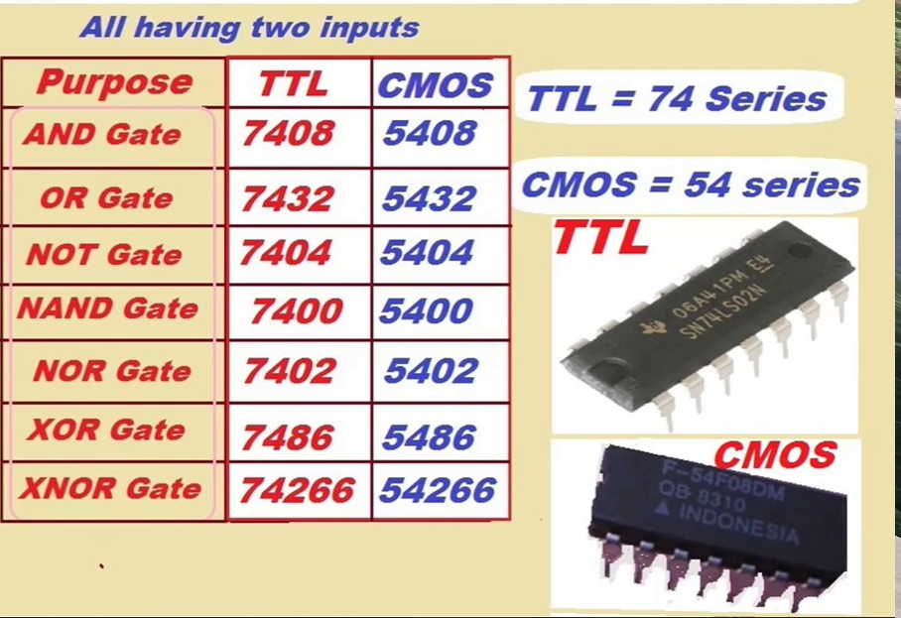
Why CMOS Gates?
List of Logic Gates with numbers
Low Power Consumption: CMOS circuits consume power only when they switch, resulting in lower overall power consumption.
High Noise Immunity: The complementary structure provides robust noise margins, making CMOS circuits less susceptible to external interference.
High Packing Density: CMOS technology allows for high integration density on a chip due to its compact design.
Compatibility: CMOS is compatible with various technologies, making it suitable for a wide range of applications.

Slide 5
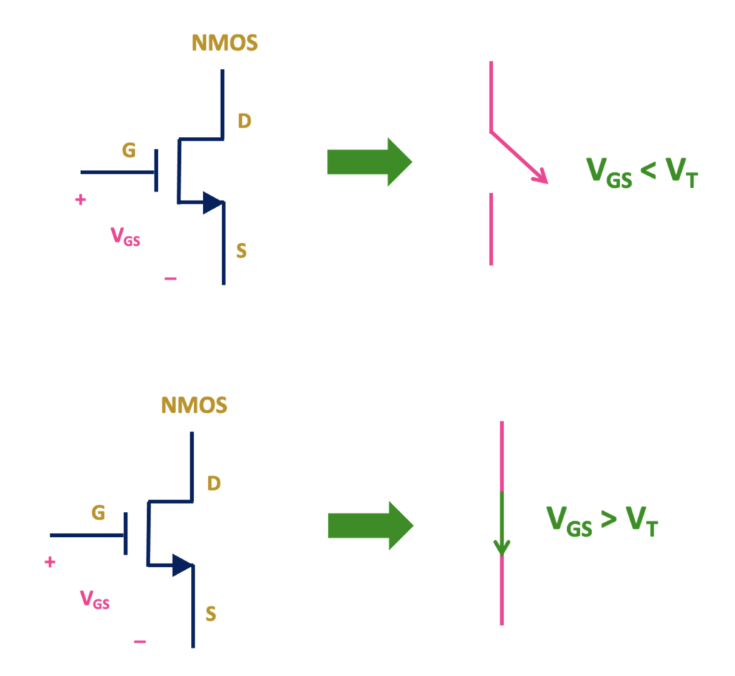
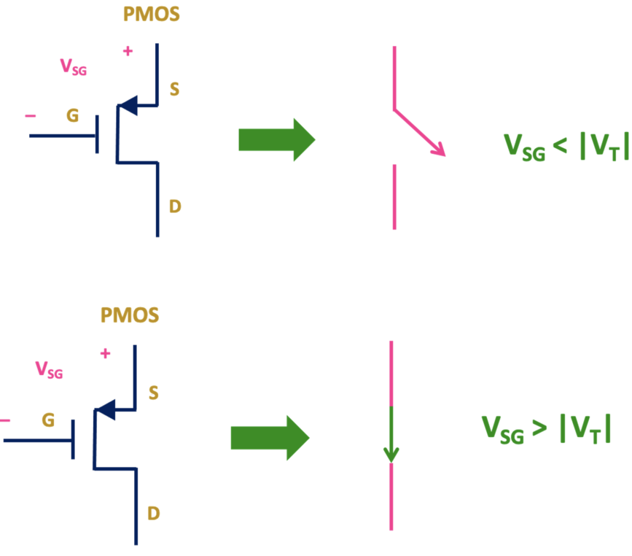
What is CMOS Logic ?
CMOS stands for Complementary Metal Oxide Semiconductor. And CMOS based logic gates uses complementary pair of NMOS and PMOS transistors. When MOS transistors are used as logic gate then they are used as a switch.
In both NMOS and PMOS transistor, the voltage applied between the gate and source acts as a control voltage.
By controlling the gate to source voltage, PMOS and NMOS transistor can be used as a switch. And they can be used to design a logic gate.

Slide 6
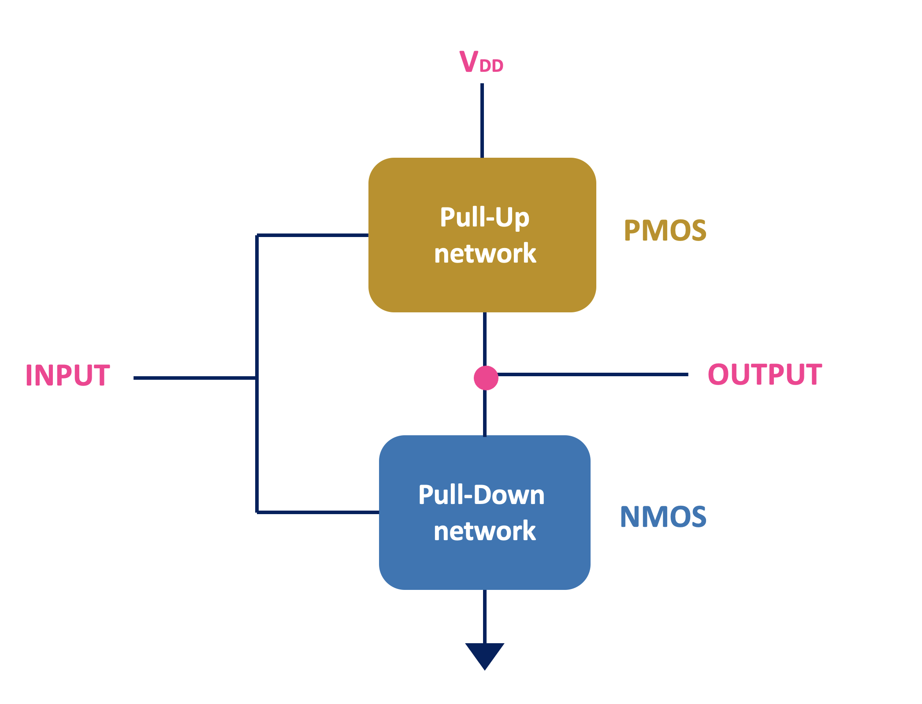
Implementation of Logic Gates using CMOS Logic
We can infer that for implementing any boolean function using CMOS technology, we need to make a switching circuit with PMOS switches in the upper block that turns on when its inputs are low, and NMOS switches in the lower block that turns on when its inputs are high. The two blocks must operate in a complementary sense. The upper block consisting of only PMOS is called a pull-up network (PUN) because it pulls up the output to VDD or logic high. The lower block consisting of NMOS is called a pull-down network (PDN) because it pulls down the output to ground or logic low. Any boolean function can be realized using PUN and PDN.

Slide 7
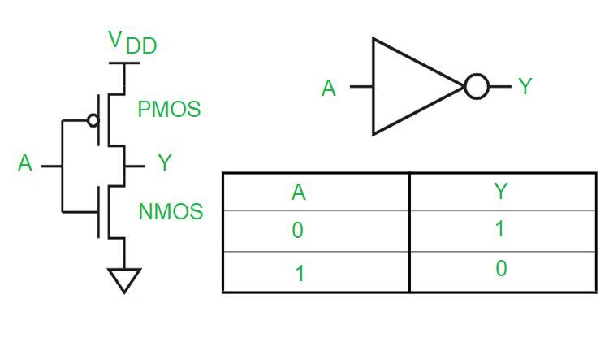
Basic Logic Gates:
Logic gates that are the basic building block of digital systems are created by combining a number of n- and p-channel transistors. The most fundamental connections are the NOT gate, the two-input NAND gate, and the two-input NOR gate.
The CMOS Inverter or NOT Gate:-
=>When input is low or logic ‘0’, then VSG > VT for this PMOS transistor and that’s why PMOS will be ON. On the other end, for NMOS transistor, VGS < VT. =>That means when input is logic‘0’, PMOS transistor will be ON and NMOS transistor will be OFF. And that’s why the output will be connected to 5V. =>Moreover, since PMOS passes strong logic ‘1’ , the output will be very close to supply voltage. That means when Vin is logic ‘0’ then output is logic ‘1’.

Slide 8
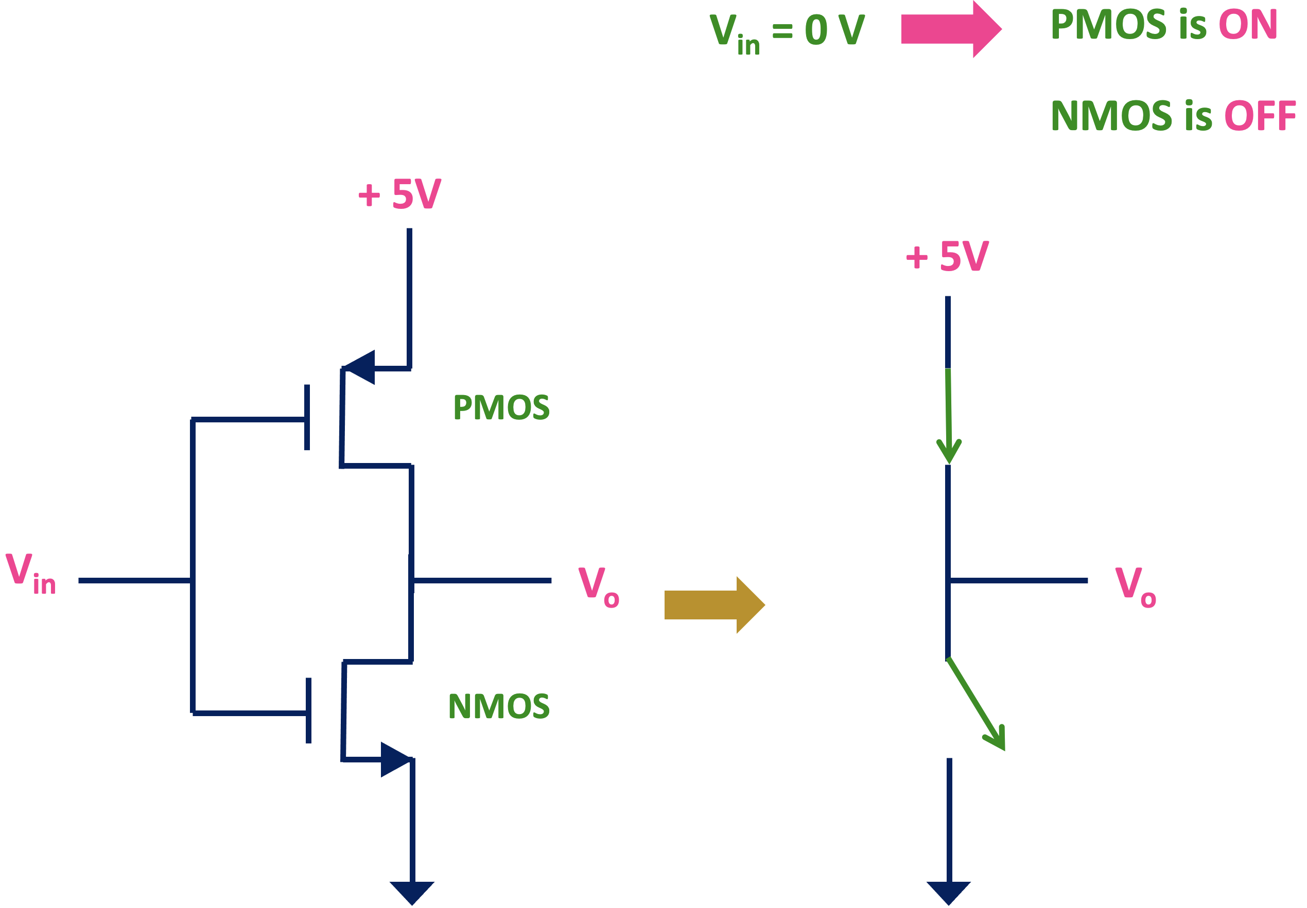
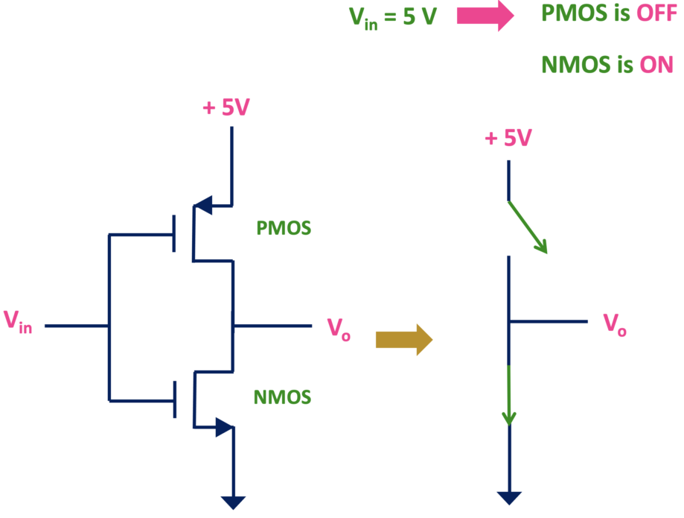
The CMOS Inverter or NOT Gate

Slide 9
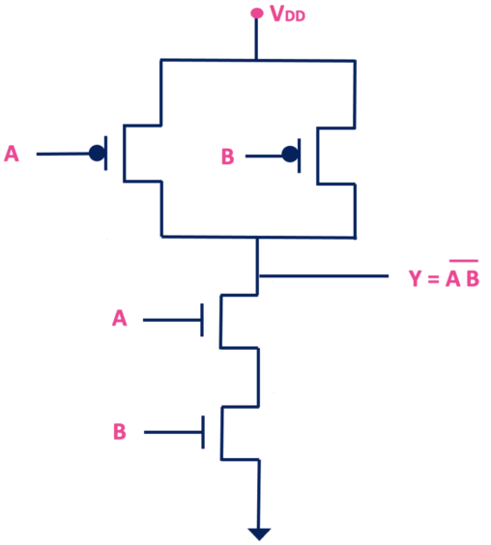
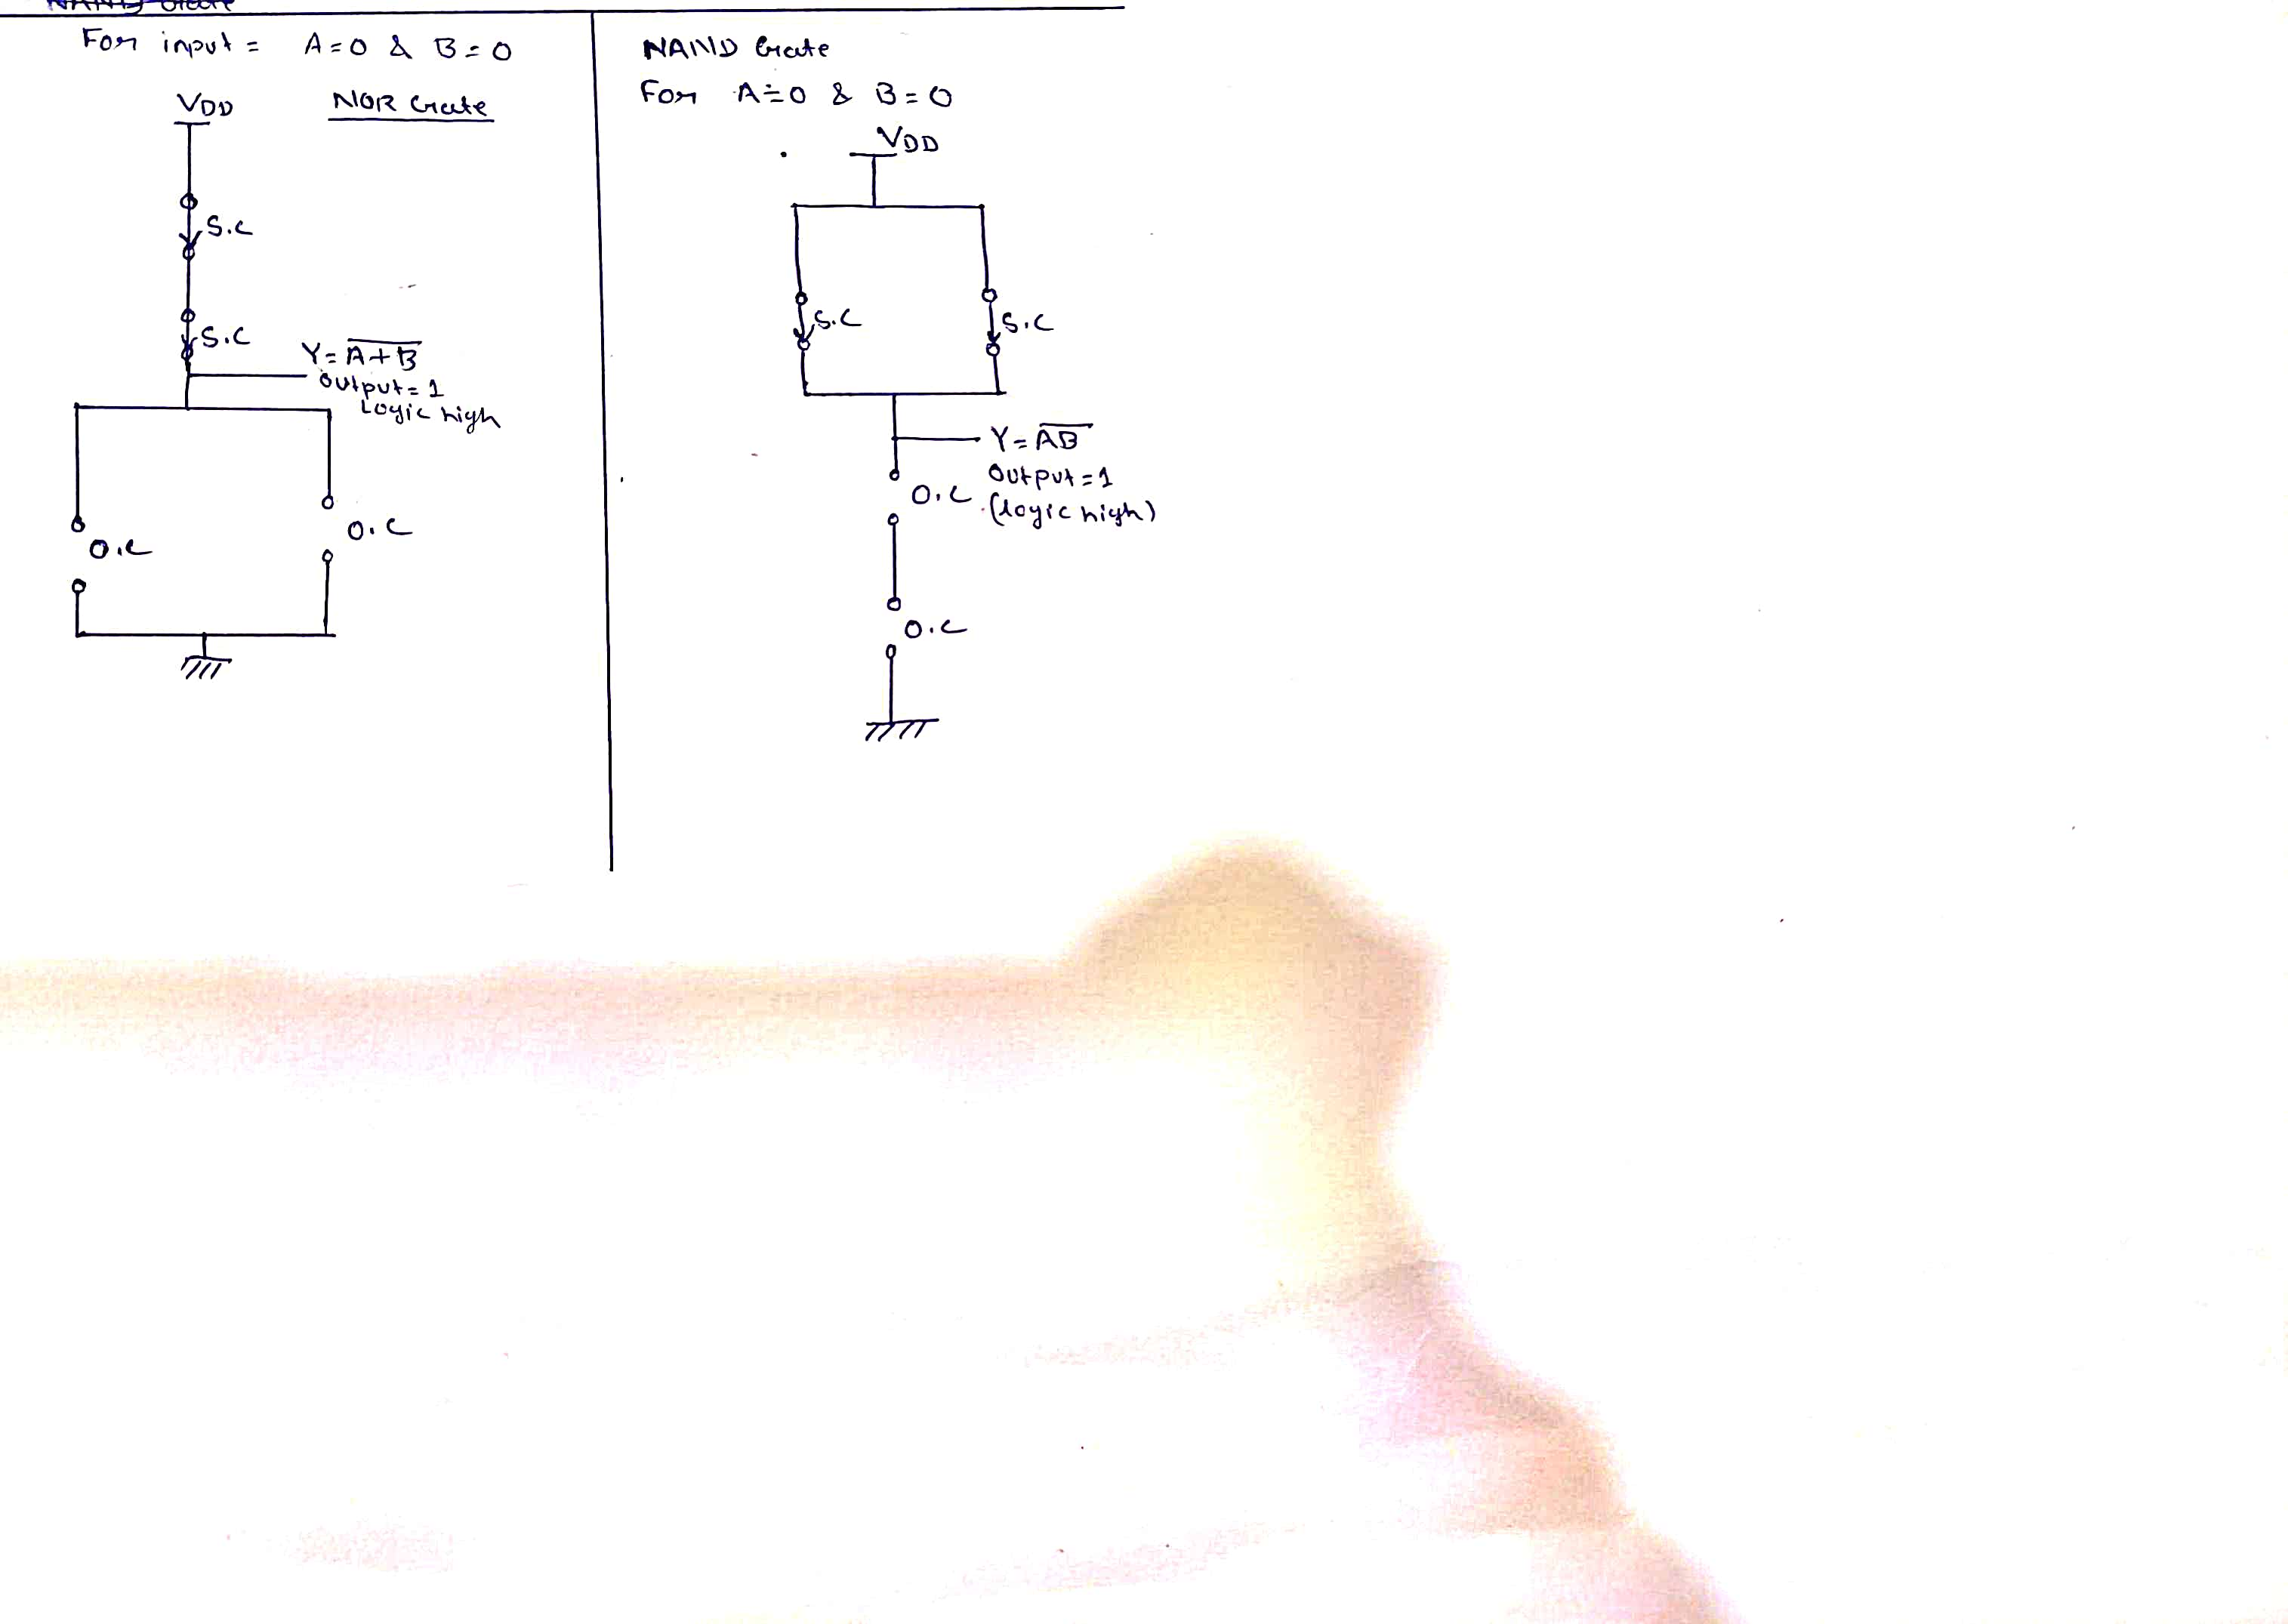
NAND Gate
Truth Table
A | B | Y
0 | 0 | 1
0 | 1 | 1
1 | 0 | 1
1 | 1 | 0

Slide 10
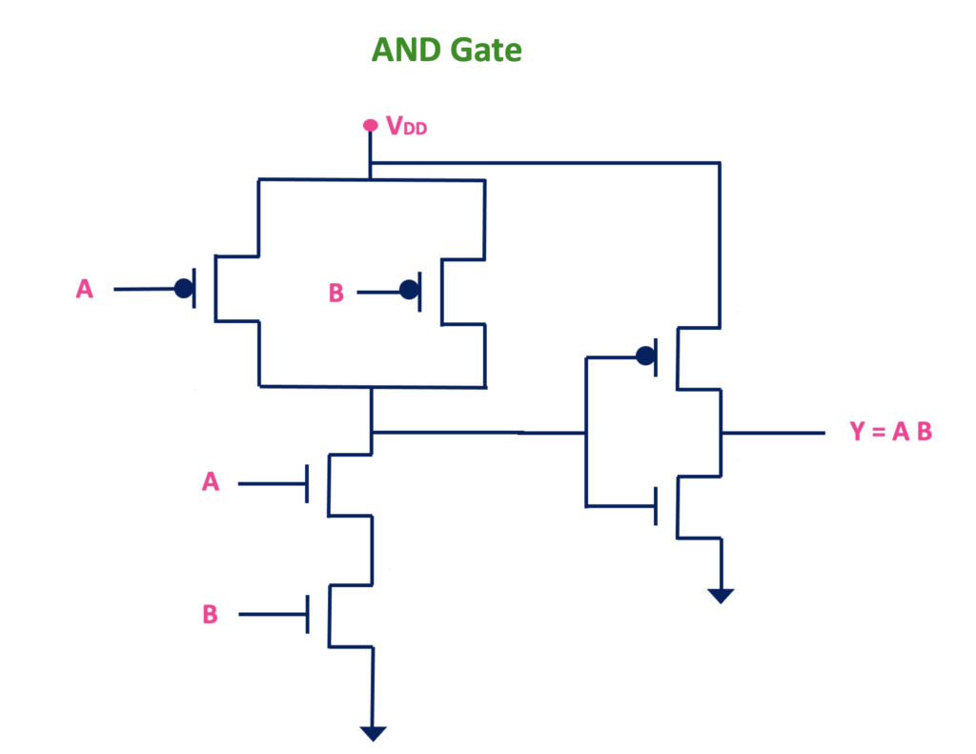
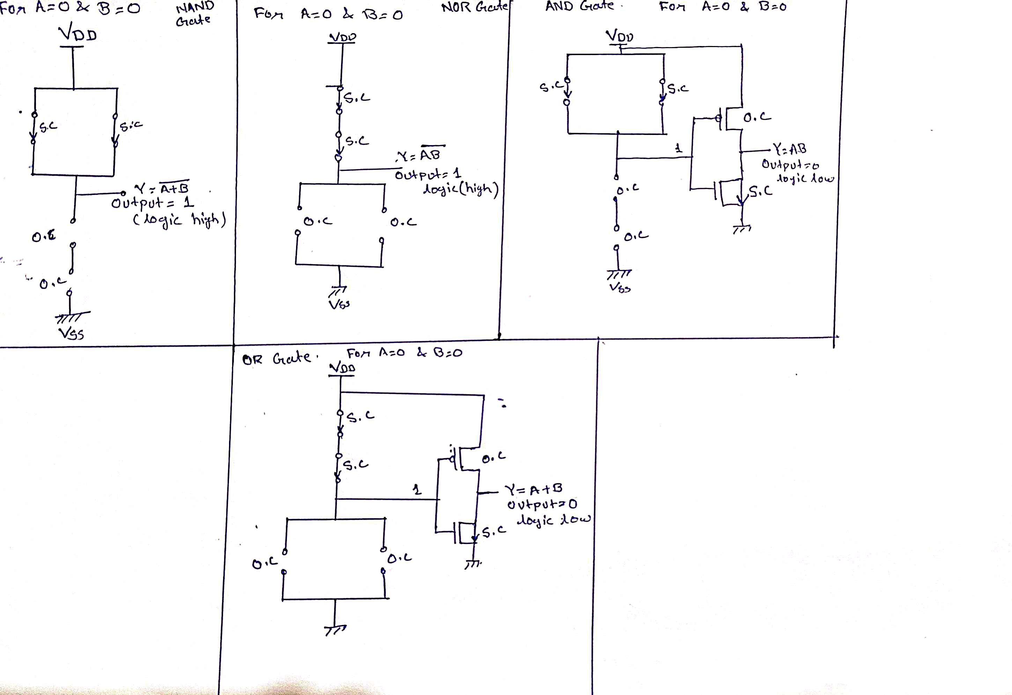
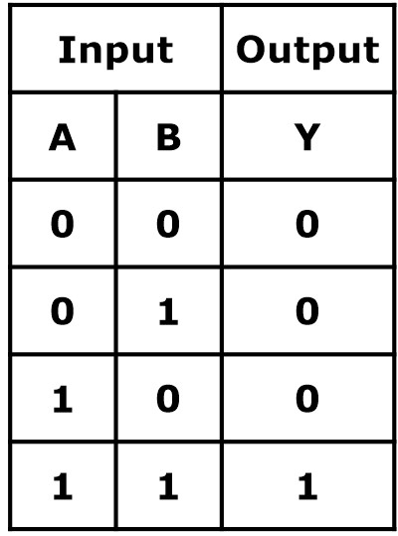
AND Gate
Truth Table

Slide 11
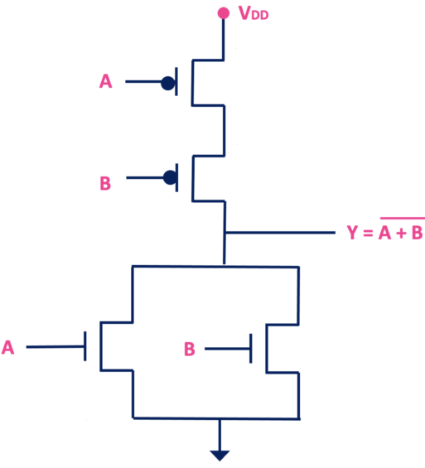
NOR Gate
Truth Table
A | B | Y
0 | 0 | 1
0 | 1 | 0
1 | 0 | 0
1 | 1 | 0

Slide 12
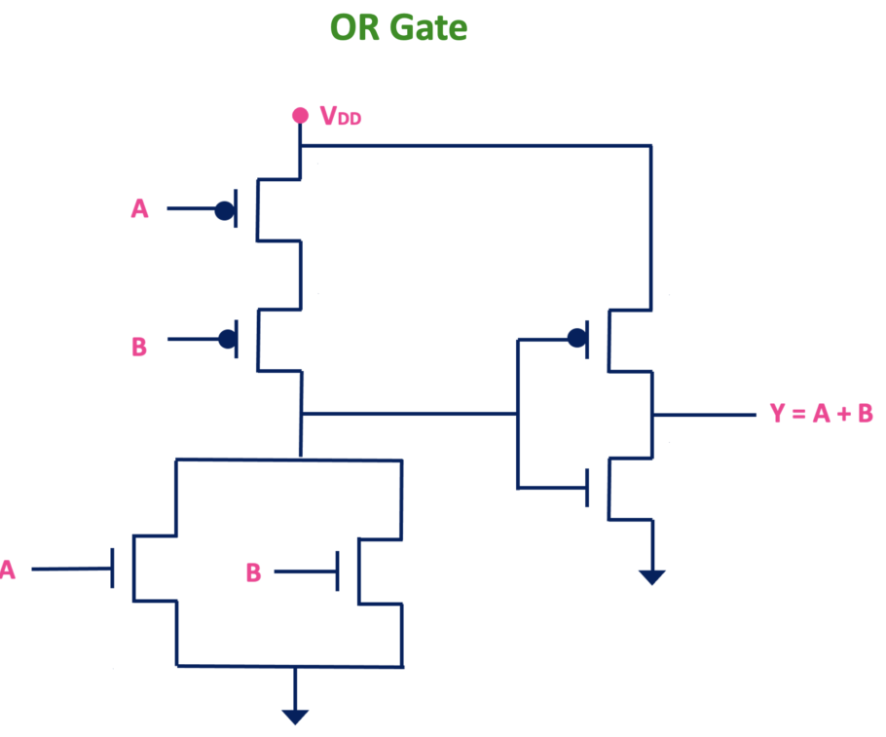
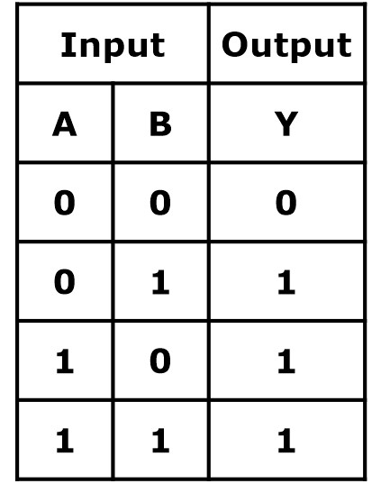
OR Gate
Truth Table

Slide 13
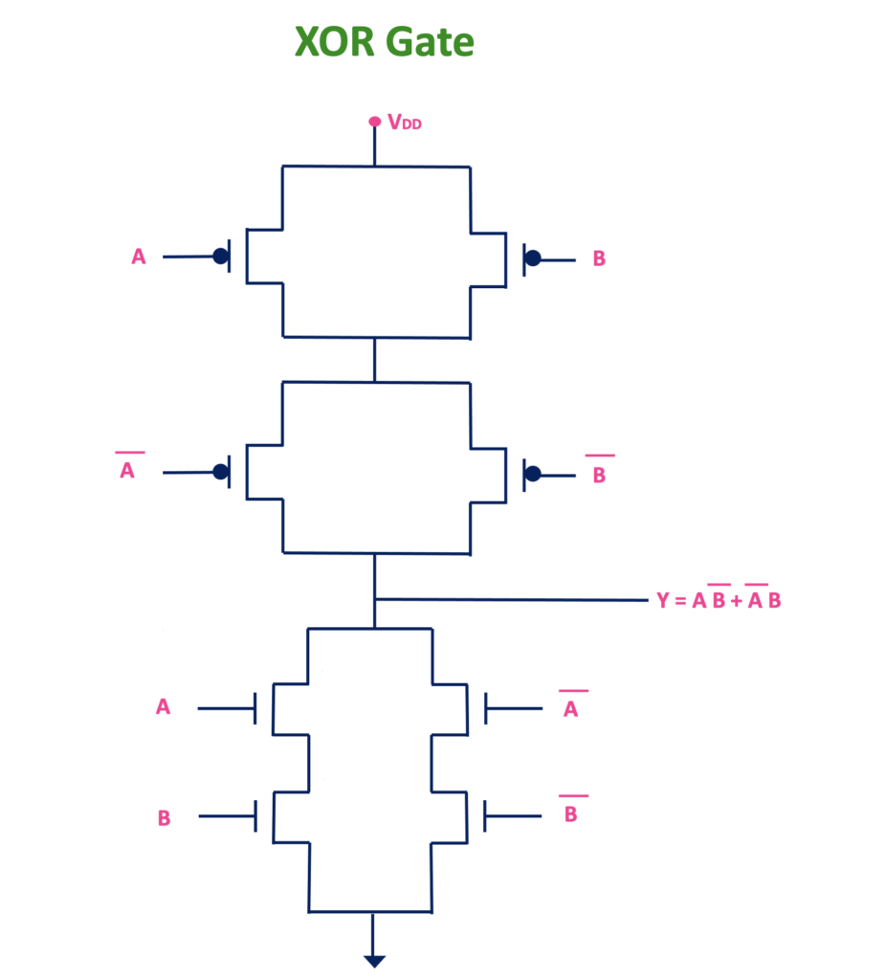
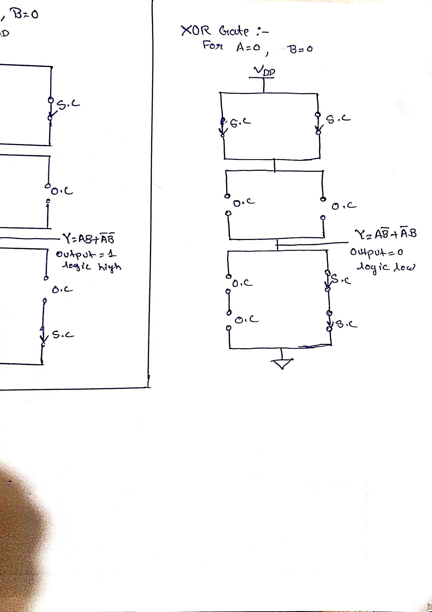
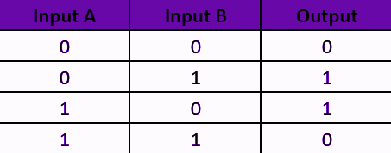
XOR Gate
Truth Table

Slide 14
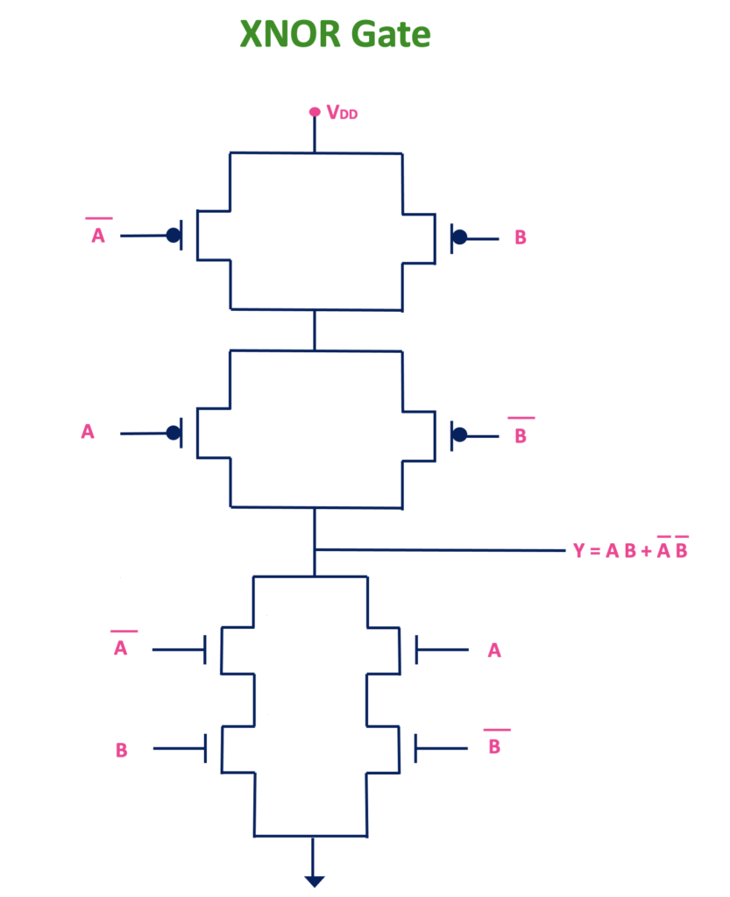
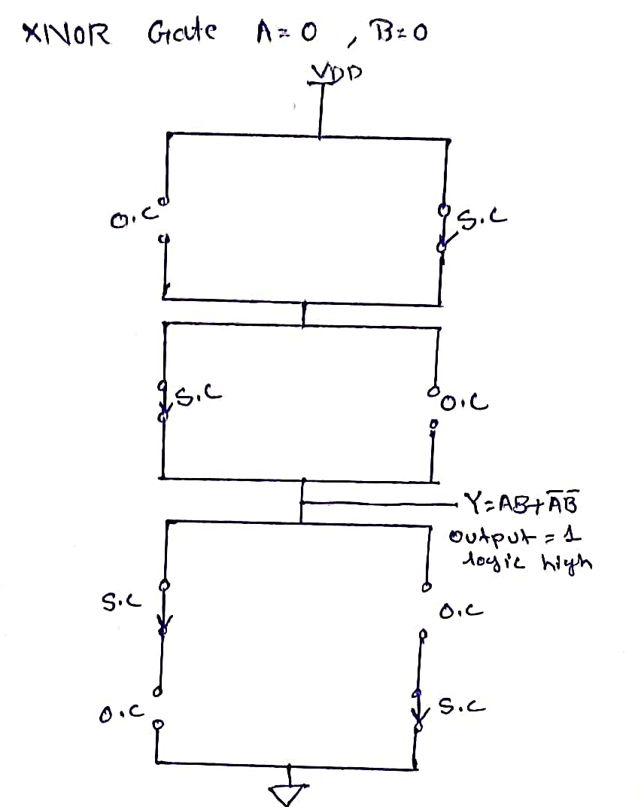
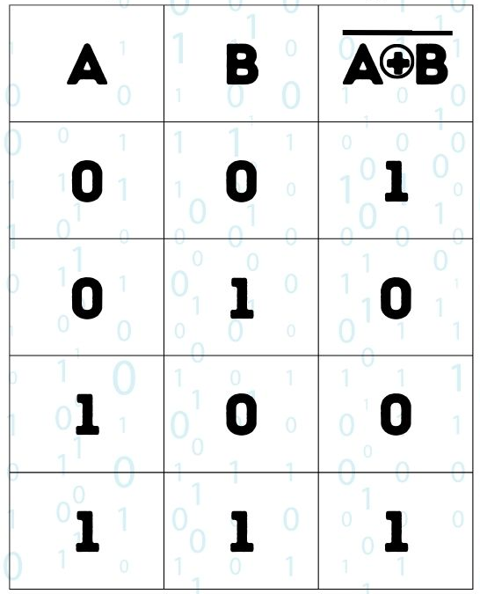
XNOR Gate
Truth Table

Slide 15
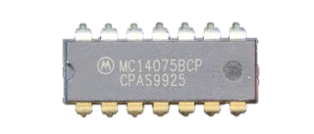
Application of CMOS Logic Gates
.
Digital Integrated Circuits
Memory Devices
Logic Circuits
Microprocessors and Microcontrollers
Communication Systems

Slide 16
Conclusion:-
In conclusion, CMOS logic gates stand out as a Key element in digital electronics. Their significance lies in low power consumption, high noise immunity, and versatility. By understanding the principles behind CMOS logic and its implementation in various gates, we appreciate its Crucial role in the design of integrated circuits. From fundamental NOT gates to complex XOR and XNOR gates, CMOS technology enables the construction of Various logic circuits. With applications ranging from microprocessors to image sensors, CMOS logic gates remain crucial in shaping the landscape of modern electronic systems.

Slide 17
Thank You

